Slide 1

JohnPaul's Unicorn Companies for Data Analytics Project.

Slide 2
Exploratory Data Analysis: Relationships, insights and visualization.
Univariate Analysis
Bivariate Analysis
Multivariate Analysis

Slide 3

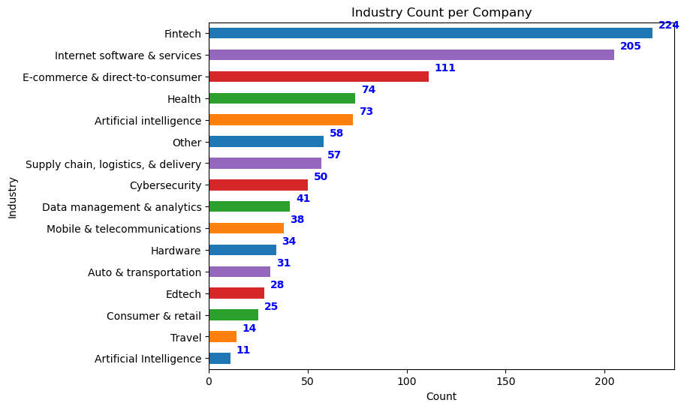



Univariate Analysis. Observation: As illustrated in the Horizontal Bar chart, the Fintech sector boasts the highest count, whereas the Artificial Intelligence industry exhibits the lowest count.

Slide 4

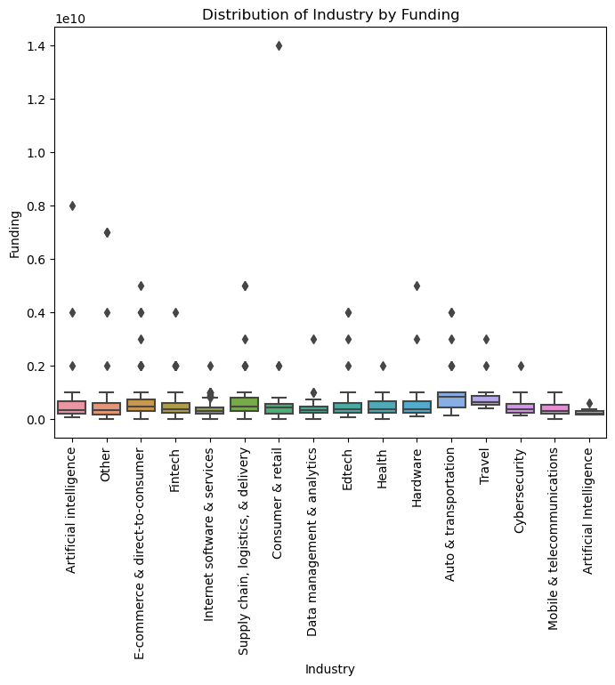
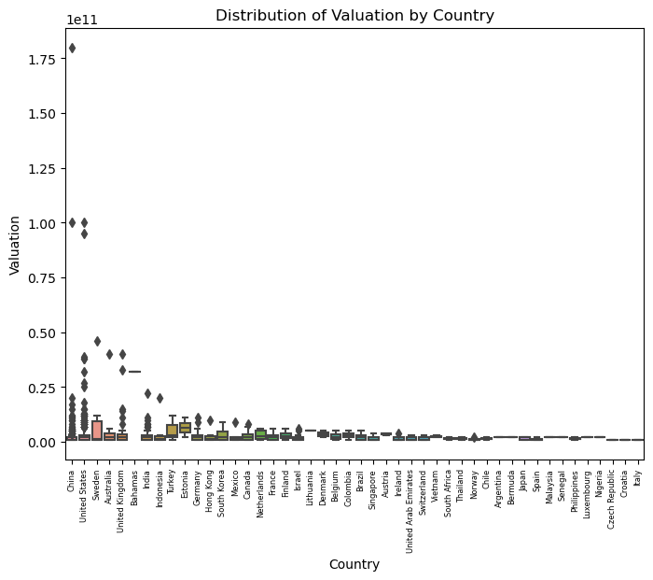
Bivariate Analysis.
Observation From Distribution of Valuation by Country:
From the Boxplot above, we can observe that Sweden has the highest Valuation by Country compared with the others, while Czech Republic, Croatia and Italy haave the lowest Valuation.
Observation From Distribution of Industry by Funding.
It is observed that Auto & transportation has the highest funding median value while the Artificial Intelligence has the lowest median value.

Slide 5

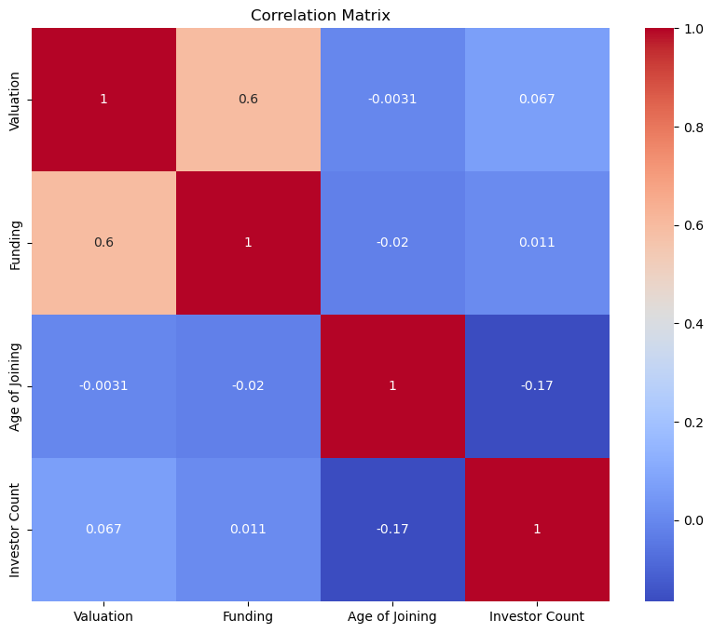
Multivariate Analysis.
Observation:
The correlation matrix and pair plot are both tools used for analyzing the relationships between variables in a dataset. The correlation matrix provides a numerical representation of the strength and direction of the linear relationships between pairs of variables, while the pair plot provides a visual representation of those relationships through scatter plots.

Slide 6
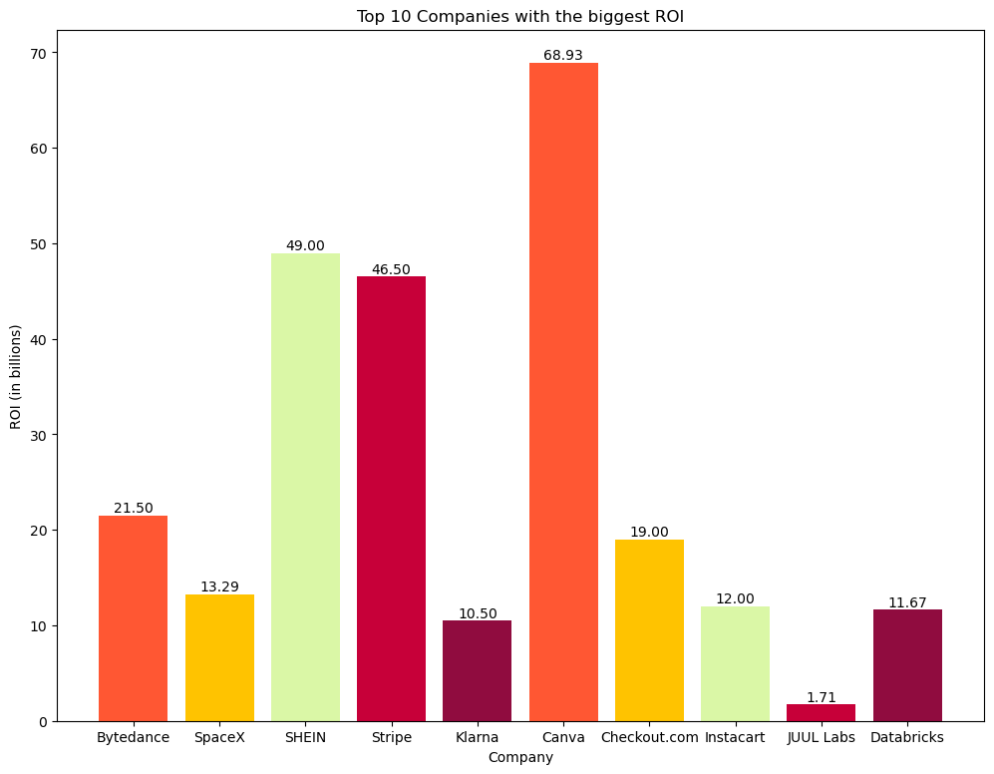
Unicorn companies that have had the biggest return on investment.
Observation:
Based on the chart, we can see the top 10 companies with the biggest ROI, with the x-axis representing each company and the y-axis representing the ROI in billions. The data labels on top of each bar show the exact value of each ROI.
We can observe that the company with the highest ROI is Canva, with a value of approximately 69.00 billion. The rest of the companies have ROIs ranging from 1.71 billion to 49.00 billion.

Slide 7
RECOMMENDATION: - To improve their business and generate more revenue in unicorn companies, stakeholders can consider the following recommendations: - Expand the Investor Network: Actively seek out and connect with a diverse range of investors. This can help attract more funding and support for growth initiatives. - Foster Strategic Partnerships: Identify potential strategic partners that can provide complementary expertise, resources, or market access. Collaborating with strategic partners can enhance product offerings, expand customer reach, and drive revenue growth. - Focus on Customer Acquisition and Retention: Implement targeted marketing and sales strategies to attract new customers and retain existing ones. This can involve personalized marketing campaigns, exceptional customer service, and continuous product improvement based on customer feedback. - Invest in Research and Development: Allocate resources towards research and development efforts to innovate and stay ahead of market trends. Developing new products or enhancing existing ones can create additional revenue streams and maintain a competitive edge. - Enhance Operational Efficiency: Streamline internal processes, optimize supply chain management, and leverage technology solutions to improve operational efficiency. This can reduce costs, increase productivity, and ultimately contribute to higher profit margins. - Foster a Strong Company Culture: Cultivate a positive and inclusive company culture that attracts and retains top talent. A motivated and engaged workforce can drive innovation, productivity, and customer satisfaction, ultimately leading to increased revenue. - Explore International Expansion: Assess opportunities for expanding into new markets or geographies. Conduct thorough market research, adapt to local preferences, and establish strategic partnerships to successfully enter new markets and tap into additional revenue sources. - Continuously Monitor and Adapt: Regularly analyze market trends, customer preferences, and competitive landscape. Stay agile and adapt business strategies accordingly to capitalize on emerging opportunities and mitigate potential risks. It is important for stakeholders to assess these recommendations based on their specific business context and industry dynamics. Implementing a combination of these strategies can help unicorn companies generate more revenue and achieve long-term success.

